Slide 1
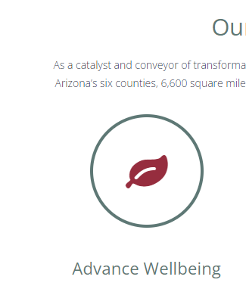
Objectives
Research available data for homelessness in Northern Arizona
Develop a reliable and valid data set to study member level impacts of homelessness and substance use
Evaluate implementation patterns of specialty housing programs

Slide 2
Methodology
Conduct Literature Review of homelessness
Use HC Claims and Enrollment Databases and Oxford House Housing Activity data to form reliable samples
Evaluate prevalence of homelessness and substance use disorders
Evaluate distribution of Oxford House Houses and Beds

Slide 3
Hypotheses Homelessness in Northern Arizona
H1: SUD will be more prevalent among the Homeless Population than Not-Homeless
H2: Homeless Population will have a higher cost to system
H3: Homeless SUD Population will have highest cost to system
H4: OHI implementation is congruent with the observed gender needs of the sample
H5: OHI homes have been established in communities with the is the greatest amount of homelessness
H6: OHI homes are established in the communities with the greatest amount of substance use disorders

Slide 4
Results Prevalence and costs of homelessness and SUD
H1: SUD will be more prevalent among the Homeless Population than Not-Homeless
H2: Homeless Population will have a higher cost to system
Table 1
Homelessness Sample Description by SUD Status
Housing Status | SUD Dx | No SUD Dx | Total
Homeless | 44 (11%)* | 130 (32%) | 174 (42%)
Not-Homeless | 20 (5%) | 218 (53%) | 238 (58%)
Totals (n = 412) | 64 (16%) | 348 (84%)
*p < .001 Source: GlobalMebers.dbo.ClientAddress, Claims.dbo.SHCAVos
64 NULL values removed because there were no claims
*p < .001

Slide 5
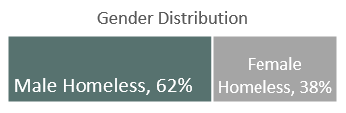
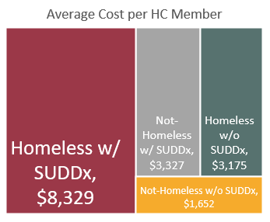
Results Prevalence and Costs; Gender Distribution
H3: Homeless SUD Population will have highest cost to system
H4: OHI implementation is congruent with the gender needs of the sample
Oxford House Implementation: House and Bed Count
Gender | Houses | Beds
Female | 8 (29.63%) | 73 (29.23%)
Male | 19 (70.37%) | 176 (70.68%
Totals | 27 | 249
*
*
* P < .001
* P < .001

Slide 6
Results Geographical impact of homelessness
H5: OHI homes have been established in communities with the is the greatest amount of homelessness
H6: OHI homes are established in the communities with the greatest amount of substance use disorders

Slide 7
Conclusions
Homelessness exists disproportionately in certain communities around Northern Arizona, namely Coconino and Mohave Counties.
Substance use disorders manifest disproportionately, with a significantly greater prevalence in Mohave County.
Yavapai county had a significantly greater number of Oxford Houses established, accounting for 63% of the total project. We asked ourselves, “Why?”
Geographical location
Pressure to contract and establish first home
We didn’t have resources to make data driven decisions

